Slide 1

The Man of God as a Husband
Men’s Ministries Training

Slide 2

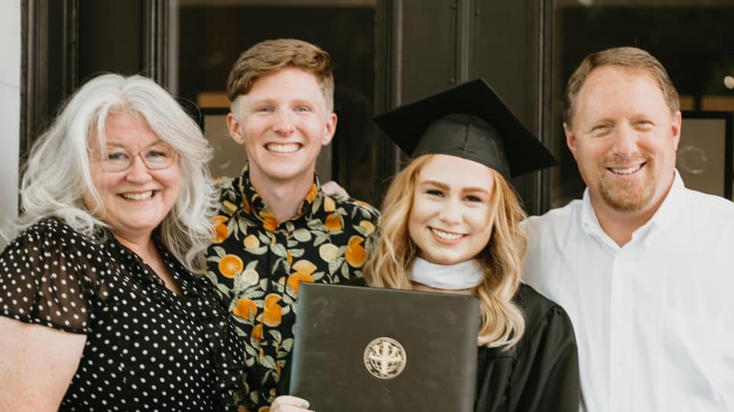

Slide 3
Proverbs 5:1-4
“My son, pay attention to my wisdom,
turn your ear to my words of insight,
that you may maintain discretion
and your lips may preserve knowledge.
For the lips of the adulterous woman drip honey,
and her speech is smoother than oil;
but in the end she is bitter as gall,
sharp as a double-edged sword.”

Slide 4
Proverbs 5:4-6
“Her feet go down to death;
her steps lead straight to the grave.
She gives no thought to the way of life;
her paths wander aimlessly, but she does not know it.”

Slide 5
Proverbs 5:7-9
“Now then, my sons, listen to me;
do not turn aside from what I say.
Keep to a path far from her,
do not go near the door of her house,
lest you lose your honor to others
and your dignity to one who is cruel,”

Slide 6
Proverbs 5:15-17
“Drink water from your own cistern,
running water from your own well.
Should your springs overflow in the streets,
your streams of water in the public squares?
Let them be yours alone,
never to be shared with strangers.”

Slide 7
Proverbs 5:18-20
“May your fountain be blessed,
and may you rejoice in the wife of your youth.
A loving doe, a graceful deer—
may her breasts satisfy you always,
may you ever be intoxicated with her love.
Why, my son, be intoxicated with another man’s wife? Why embrace the bosom of a wayward woman?”

Slide 8
Proverbs 5:20-23
“For your ways are in full view of the Lord,
and he examines all your paths.
The evil deeds of the wicked ensnare them;
the cords of their sins hold them fast.
For lack of discipline they will die,
led astray by their own great folly.”

Slide 9
Adam rebelled against God because he was afraid of losing Eve.
David caused pain to many because he wanted Bathsheba.
Samson lost his eyes and ministry because of Delilah.
Solomon was led astray by his love for many women.

Slide 10
Foundational Principals
Love and loyalty to God first.
Preparing the heart for marriage.
Spiritual beliefs above passion.
Seeking godly counsel and growth.

Slide 11


Unhappy Couples
Happy Couples

Slide 12

“It is not good for a man to be alone”
Gen. 2:18

Slide 13

Soul mates
You complete me

Slide 14
Six Basic Fears
Abandonment
Rejection
Unworthiness
Inadequacy
Failure
Inferiority

Slide 15
Everything would be great if you changed.

Slide 16

I choose to love and accept you as you are

Slide 17
Ephesians 5:32, 33
“For this reason a man will leave his father and mother and be united to his wife, and the two will become one flesh.” This is a profound mystery—but I am talking about Christ and the church. However, each one of you also must love his wife as he loves himself, and the wife must respect her husband.

Slide 18
Adore
Admire

Slide 19
John Gottman Keys
Emotional Connection
Bids for connection
Intentional repair

Slide 20
Ephesians 5:21
“Submit to one another out of reverence for Christ.”

Slide 21
When one person wins in conflict the relationship loses.
Your spouse is not your enemy.
Mindset of service

Slide 22
60% of conflict is not solvable.
The goal of conflict is understanding.
Proverbs 18:2 “A fool does not delight in understanding but in airing his own opinions.”

Slide 23
Conflict affects men more. They feel the effects of marital stress more strongly than women do.
When a man is treated rudely his heartrate will go up and can stay high for 20 minutes.

Slide 24
Gary Chapman – 5 Love Languages

Slide 25
Gary Chapman – Five Love Languages
Quality Time
Acts of Service
Physical Touch
Words of affirmation
Gifts
(Serve Her)

Slide 26
Why men don’t get enough sex and women don’t get enough love.
Emotional Connection
Adore/Admire

Slide 27
John 3:19-21
“This is the verdict: Light has come into the world, but people loved darkness instead of light because their deeds were evil. Everyone who does evil hates the light and will not come into the light for fear that their deeds will be exposed. But whoever lives by the truth comes into the light, so that it may be seen plainly that what they have done has been done in the sight of God.”

Slide 28
Challenges for Men
Lack of Role Models
Father wounds
Unprocessed scar tissue
Beliefs that women can heal wounds

Slide 29
Avoiding Patterns
Abraham and Issac
Genograms
Intimacy = Into me see

Slide 30
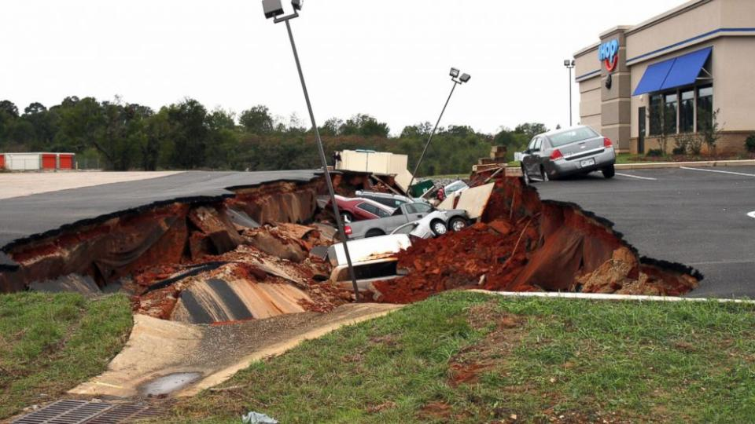
“Christ in us the hope of glory.”
Colossians 1:27

